Slide 1
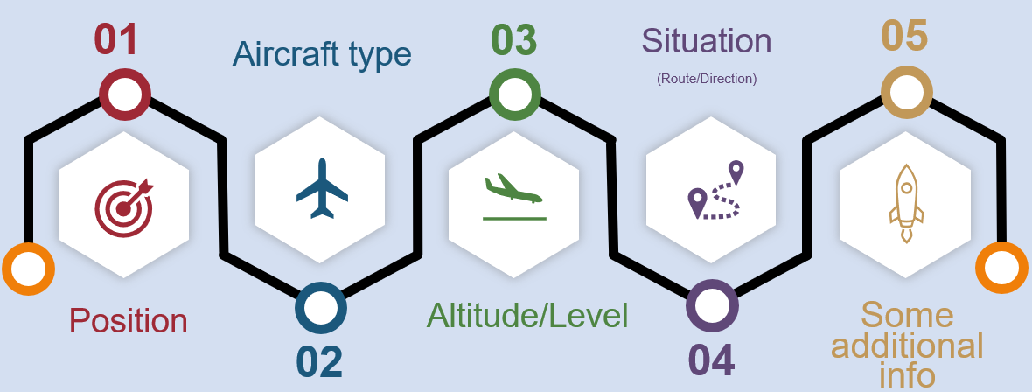
Essential Traffic Information #PAASS

Slide 2
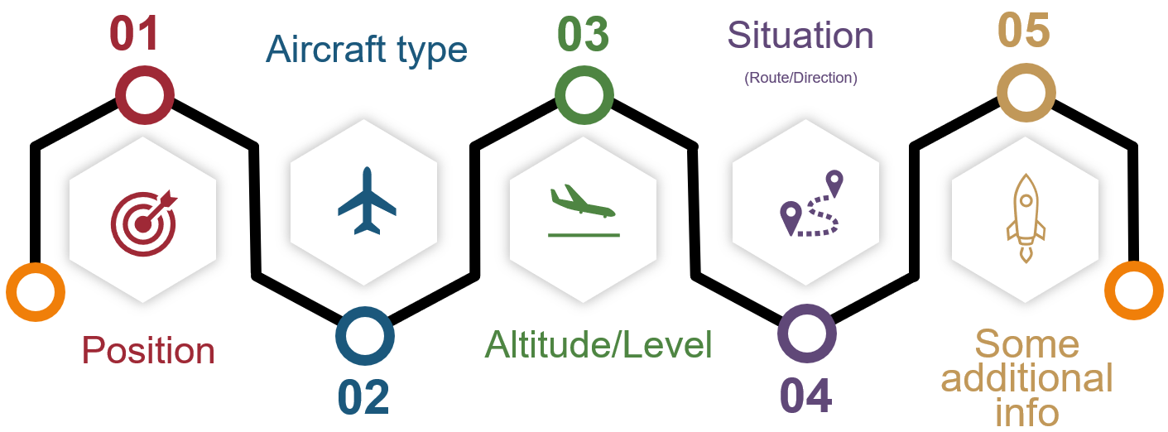
Essential Traffic Information #PAASS

Slide 3
Prevent Runway Incursions #SCAN
1. Scan the threshold
2. Scan the intersection
3. Scan runway end
4. Cleared to Cross, Take-off or Land

Slide 4
Prevent Runway Incursions #SCAN
1. Scan the threshold
2. Scan the intersection
3. Scan runway end
4. Cleared to Cross, Take-off or Land

Slide 5
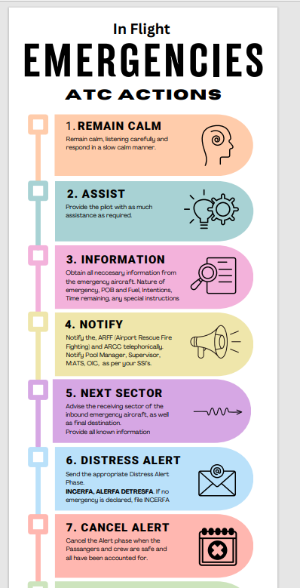

Slide 6
